Slide 1
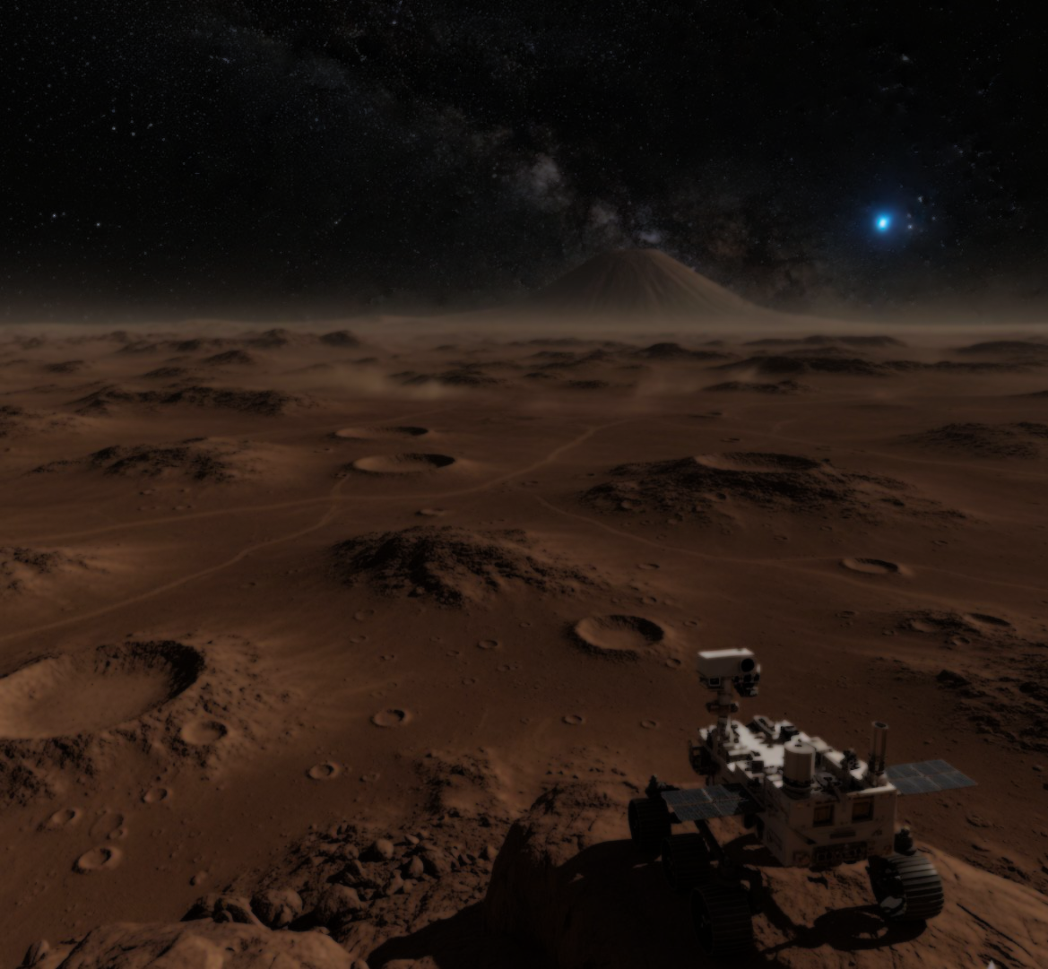

Project Ellipse
HOW TO REVOLUTIONIZE THE WASTE RECYCLING ON MARS OUR WAY

Slide 2
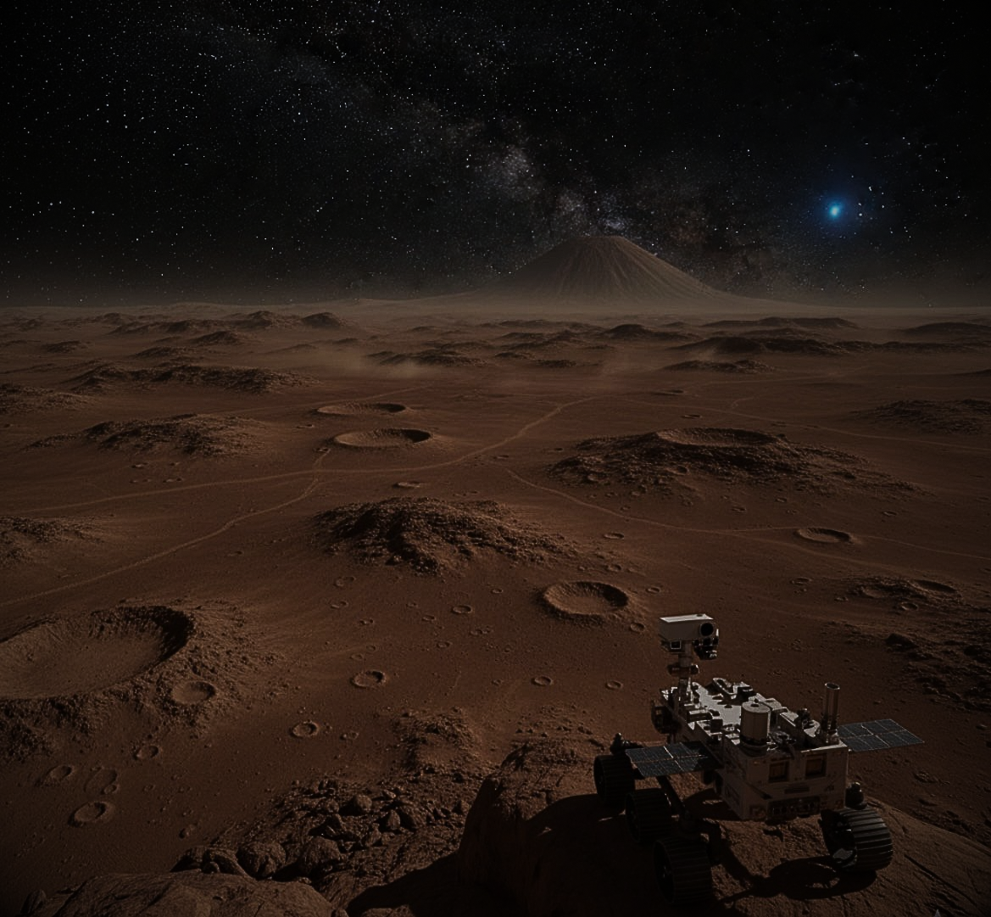
Project Ellipse
In our world, space exploration is a very important part since humanity is advancing to stars. But how do we make it sustainable? Getting there is a challenge, and we have to manage our life on the red planet. One of the important aspects is a proper inorganic trash management during the mission. That is where Project Ellipse takes place.

Slide 3

Project Ellipse
What is it and How does it work?
Project Elipse is a compact recycling station which is used for collecting materials separately and recycling them inside of the specific chambers located in the body of the station. The device can recycle: polymers, synthetic fibers, plastic, metals, composites. To get recycled an item would be directed at the proper chambers. After the recycling, materials transformed in specific chamber into ingots, plastic coil or plastic threads. The end products being redirected and collected through the dispenser point on the left side of the station. The desired end form can be chosen through the interface of the machine which is located at the front.

Slide 4
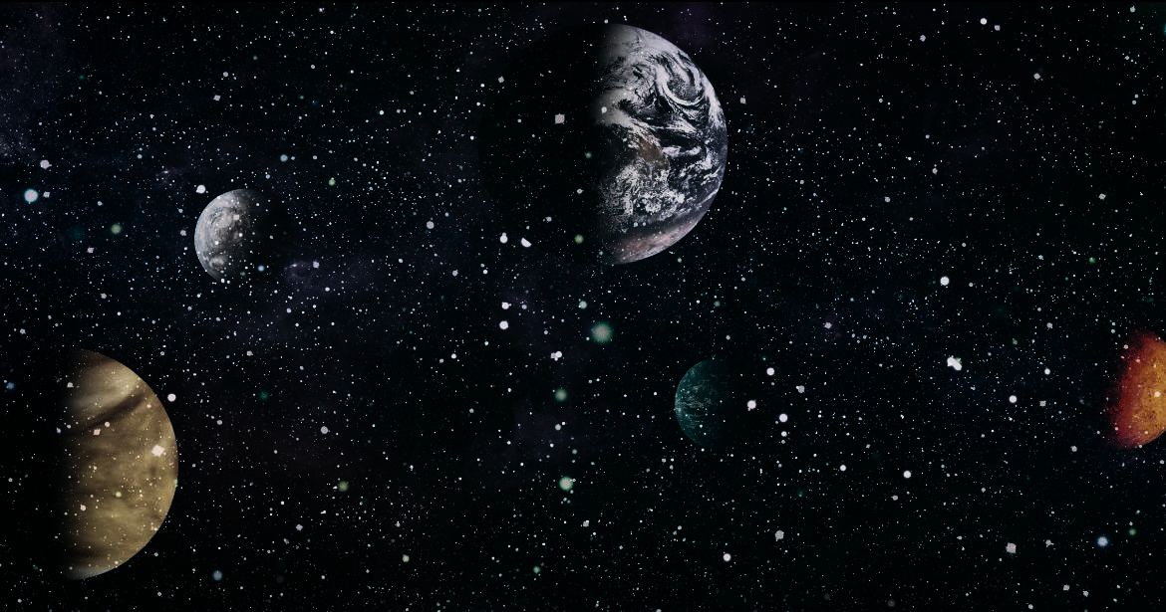
Project Ellipse
What are the components?
The station is made of 3 intakes for different types of waste. It has 3 chambers used for recycling which are interconnected with eachother allowing for a material to be subjected to multiple procedures. Sections are: Heating chamber, grinding chamber, and shaping chamber.

Slide 5
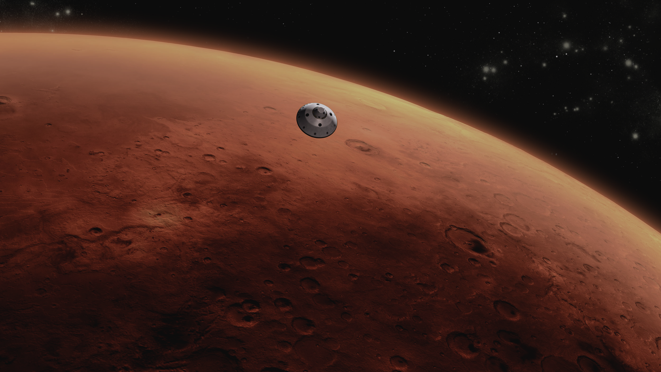
Project Ellipse
Why is it worthy to use?
The station helps solve a significant problem which is dealing with waste millions of miles away from Earth. On Mars, sending disposing of trash instead of recycling it would cost too much. Recycling and reusing inorganic waste like packaging, fabrics, and materials can save resources, reduce costs, and protect the Martian environment. While helping astronauts to create a self-sustaining system, where nothing is wasted and everything is reused. This kind of system is not only important for Mars but also for Earth.

Slide 6

Project Ellipse
What sets our concept apart is the way it transforms ordinary materials into extraordinary resources:
Why are we better than our competitors?
Old clothing and textiles are remanufactured into 3D printing filament for tools and habitat panels
.
Shredded waste is combined with Martian soil to form durable bricks and insulation for habitats.
Our design represents an innovation with no rival, a breakthrough that cannot be replaced or replicated. Unlike conventional approaches, it requires less technology yet delivers more efficiency, making it both energy-saving and environmentally unmatched. Its strength lies in dependability and simplicity, eliminating unnecessary waste and reducing power consumption. This is not just another recycling system; it is a once-in-a-generation leap forward.
No other system merges simplicity, creativity, and sustainability in this way. Our invention is future-ready, irreplaceable, and designed exclusively to support life on Mars — not just as a solution, but as the only solution capable of ensuring survival and progress in the Martian environment.

Slide 7

Project Ellipse
Conclusion
Project Ellipse aims to address a critical issue of the mission to Mars: waste disposal and recycling. We have proposed a new revolutionary machine that recycles waste products to create new products. The machine contains four chambers and three inlets and can make life on Mars sustainable. The need for waste disposal can be reduced by up to 70%. Project Ellipse should be considered as a valuable contribution to making life on Mars possible and sustainable. The design emphasises simplicity and the efficient use of resources. The system was made exclusively for life on Mars in a way that works with the Martian environment.

